Slide 1
Finance and Risk Analytics – Capstone Project
By – Anvi Radhakrishna Naik

Slide 2
Problem statement
To identify the right investment opportunity from different sector and recommend a portfolio as per the invertors need.

Slide 3
Investor Background
It’s a Father and Son duo , approached for the investments.
Patrick Jyengar - He is a conservative investor and he wants to invest 1 million dollars and expects double of his capital with less risk in the coming 5 years. He also wants to invest 500K dollars in a magazine(Naturo) and later wants to buy a minority portion of the same.
Peter Jyengar - He is an aggressive investor and he wants to invest 1 million dollars into most high margin stocks & expects retunes within 5 years.

Slide 4
Business Task and Objectives:
Analyzing the portfolio of stocks to provide consultation on investment management based on the client’s requirements.
Identify the stock trends among different sectors.
Come up with a investment strategy , according to the investors requirements.

Slide 5
Data Preparation and Understanding
We have 24 leading companies data from October 2010 to September 2020.
And all these companies are listed in NYSE, and have been provided with a benchmark file for the same period. i.e. S&P500.
Stocks belong to different domains: Technology , Aviation , Pharmacy , Finance and Heath Care.
Data do have the below values for the date range: Date, Open - Price of stock at the start of day , Close – Price pf stock at the end of day, High Price - Highest price reached by the stock on that day , Low price - Lowest price reached by the stock on that day , Adjusted close price - Stock price adjusted to include the annual returns (dividends) that the company offers to the shareholders , Volume - Number of stocks traded on the day

Slide 6
Data Preparation and Understanding
Investors are looking for 5 years of investment, so we trim the data accordingly to the need and analyze.
Merge all the 25 data set in to a single data set , before analysis.
Data preprocessing steps needs to be done for the data , before that do the below
Identify the company and the industry from the collated data for company-specific and industry analysis.
For the daily price / stock analysis , Will be using Close, Volume,
Get rid of other redundant data present in the data set.
Use required Charts for analysis and also preform calculation required for analysis w/ and w/o Normalization techniques.

Slide 7
Data Preparation and Understanding
Here for analysis and visualization , Python and its libraries are considered.
Build the data frame like below for closing prices and volume of each company you have in the data set against the date field
i.e. Date has the index column and closing price of all the available company has stock data available for that particular day
| Goog |IBM | Appl |AMNZ |.....
Date | | | | |…..
Analyze both the data frame , for better understanding.

Slide 8
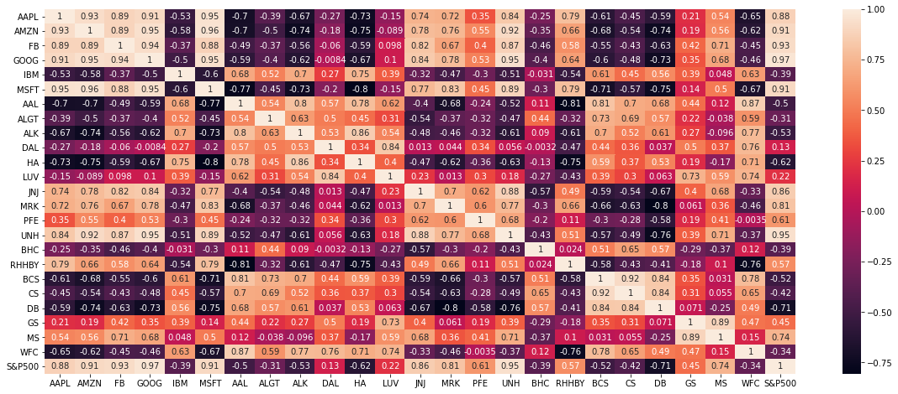
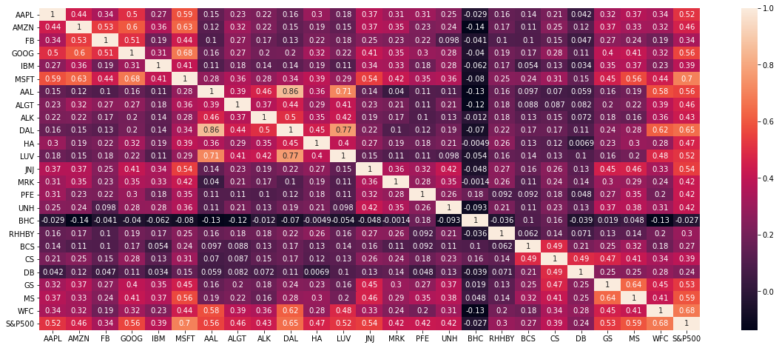
Data Exploration
Handle the data with missing values and treat the same.
Find the correlation matrix for Stock Price and Volume
Ideally, the stocks that have negative correlation with the Index (S&P 500) should be avoided in the portfolio since they may prove to be very risky.
Stock : We observe a strong correlation among most of the Technology Sector compared with others.
Volume : S&P500 has a positive correlation with all the stock except with BHC
Correlation of Close Price
Correlation of Volume Price

Slide 9
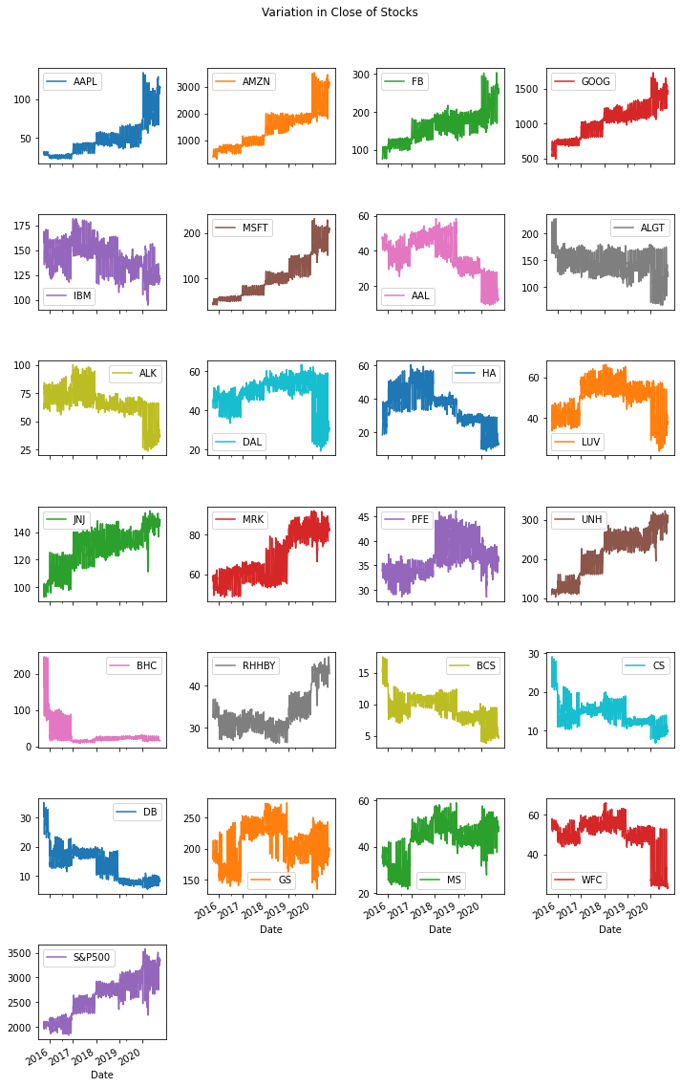
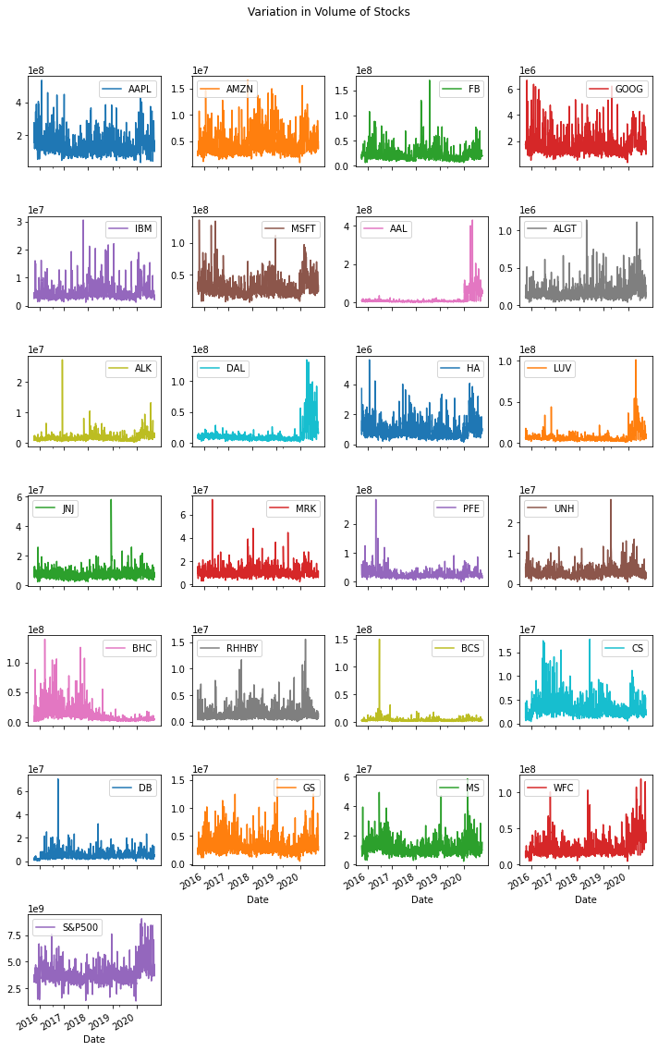
Sub-plots to visualize the Close stock and volume

Slide 10
Sub-plots to visualize the Close stock and volume
For the last year , if we check the volumes and stock price of each company
For most of Technology sector except IBM, the volumes have gone up and few other companies from other sector as well
Trading volumes have gone down in ALK, BCS, DB, BHC, JNJ and PFE.
We should consider stocks that have a positive movement suggesting that the price has increased during the given period
Also, it suggests that the prices are expected to show an uptrend in the future.
The price of aviation and banking stocks has gone down. The highest drop in the prices can be observed in DB and BHC.
Like mentioned The volume and stock price movement in most technology stocks is observed in sync with S&P 500.

Slide 11
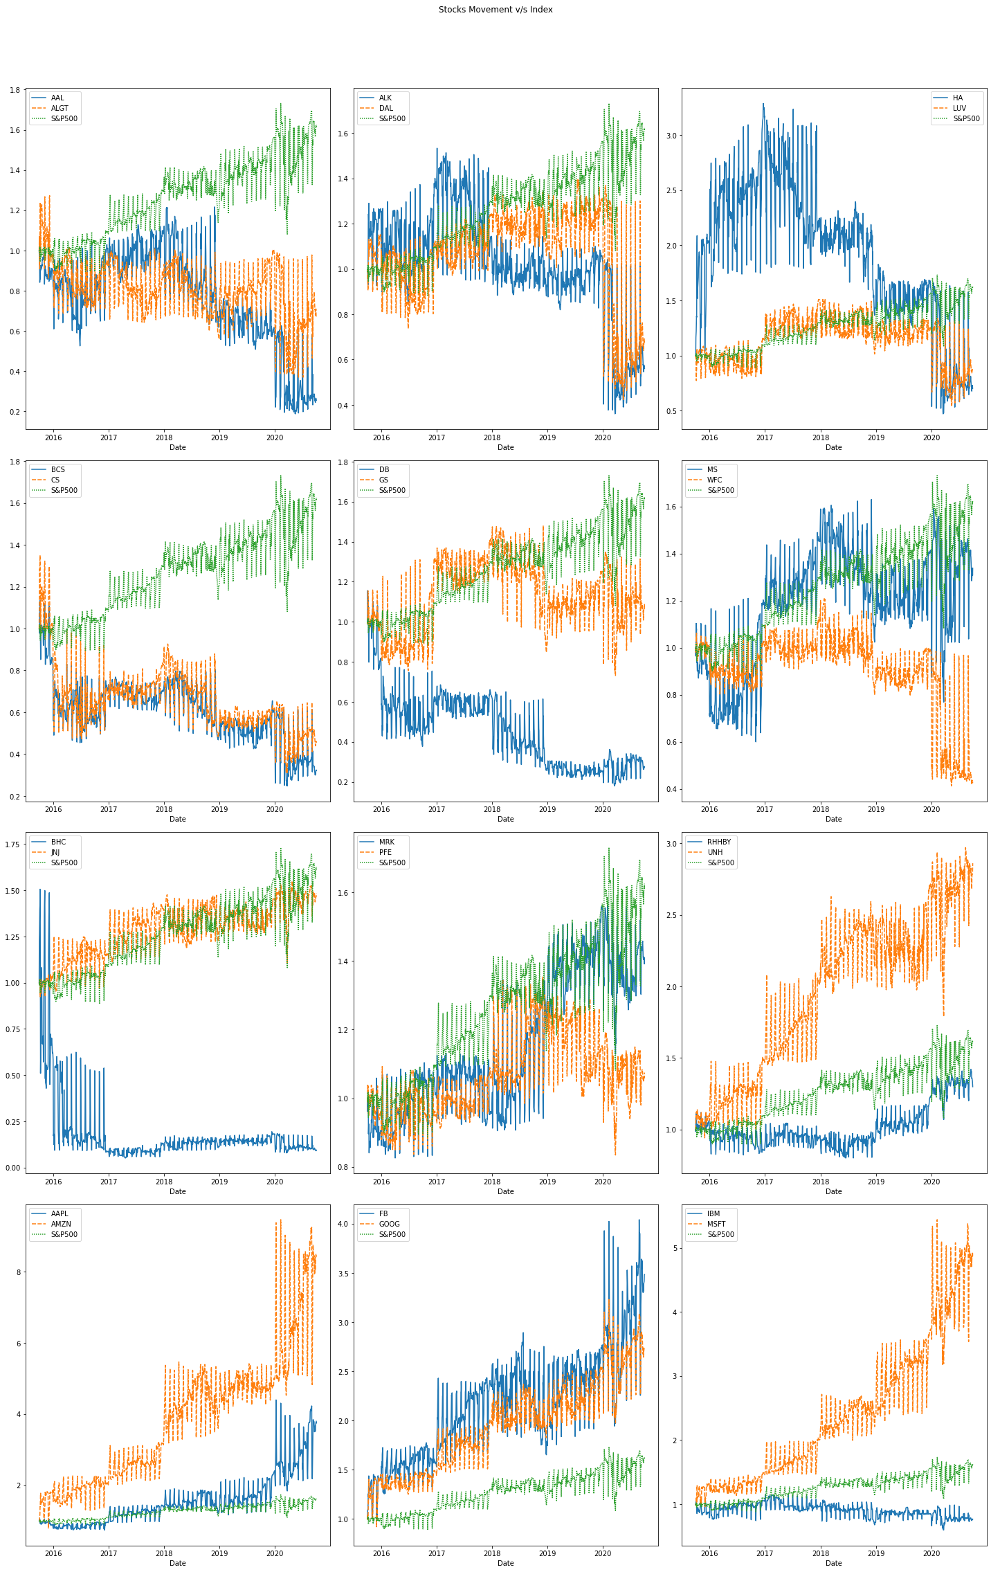
Normalization of stock price
In Tech sector wise; MSFT, GOOG, FB, AAPL, AMZN are showing an uptrend, whereas IBM is showing a downtrend.
In healthcare sector wise, BHC and PFE are showing a downtrend
In Finance sector wise ; DB, BCS, CS and WFC are showing a downtrend
In aviation sector wise; HA, DAL, AAL are showing a downtrend.

Slide 12
Basic Financial Analysis
Relative Strength Analysis - Amazon , shows the highest return of all time compared to other various industry followed by Google , Apple, MSFT, fb
Daily Returns - Google has a very high daily return and based on the all company wise , as well MSFT seems quite hand in hand and a major times we have seen a good and low daily returns.

Slide 13
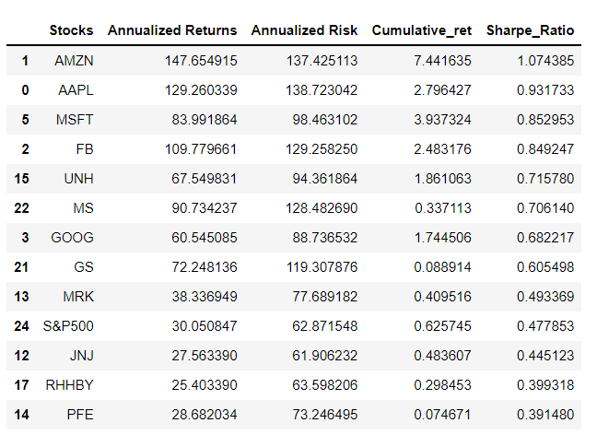
Descriptive analysis
Doing a Descriptive Analysis to understand, the overall situation of data and the relationship between data.
Average Daily Returns (Mean), Risk (std), Annualized Returns , Annualized Risk , min , max , Cumulative returns and sharp Ratio – are been analyzed thoroughly.
We should consider risk factor while making a portfolio, since though there could be an uptrend, there could be higher risk involved too.
To be in sync with the investment goals of the investors, we will not include any stocks giving negative returns in the portfolio.
Stocks with negative Sharpe Ratio should not be included in the portfolio. Ideal Sharp Ratio is 1

Slide 14
Investment recommendation
Portfolio for Mr. Patrick , I would provide a Conservative portfolio with lower risk and good returns
AMZN- 15%
MSFT - 17%
Apple - 13%
Google - 12%
Also in case , he can invest on other sector has below , risk is low and quite high returns , excluding Technology sector
MRK - 10%
JNJ - 10%
RHHBY - 12%
GS - 4%
PFE - 8%
Peter's portfolio, I have made it a point that he gets an exposure to all industries. Since he is young and willing to take risks, we have given him a well diversified portfolio.
AMZN- 15%
MSFT - 15%
Apple - 12%
FB - 10%
Google - 8%
MRK - 12%
JNJ - 10%
RHHBY - 10%
GS - 5%
PFE - 5%

